Slide 1
CHAPTER 1
Software
Development
Process

Slide 2
Software Development Process
What is Software?
Software can define as: ''Collection of computer programs, procedures, rules, associated documents and concerned data with the operation of data processing system.‘’
Software is divided into two broad categories:
System software: It is responsible for controlling and integrating the hardware components of a system.
Example: Operating system
Application software: It is used to accomplish some specific tasks. It should be collection of small programs.
Example: Microsoft word, Excel, Railway reservation system etc.

Slide 3
Software Development Process
Hardware vs. Software
Hardware | Software
Manufactured wear out Built using components Relatively simple | Developed/ engineered deteriorate Custom built Complex

Slide 4
Software Development Process
Software Characteristics
Understandability
Cost
Maintainability
Modularity
Functionality
Reliability
Portability
Correctness
Documentation
Reusability
Interoperability
Verifiability

Slide 5
Software Development Process
What is Software Engineering?
Definition : The application of systematic, disciplined, quantifiable approach to the development, operation, and maintenance of software; that is, the application of engineering to software.
Its a discipline that is concerned with all aspects of software production.
Three main aspects of Software Engineering are:
Provide quality product
Expected cost
Complete work on agreed schedule

Slide 6
Software Development Process
Software Engineering – Layered Technology
Tools: CASE preferred
Methods: technical “how to’s”
Process model: the “framework”
A quality focus: the “bedrock”

Slide 7
Software Development Process
Process Framework
Software Process
Process Framework
Umbrella Activities
Process framework
Umbrella Activities
Framework activities
work tasks
work products
milestones & deliverables
QA checkpoints
Framework activity 1
Framework activity n

Slide 8
Software Development Process
Umbrella Activities
Software project tracking and control
Formal technical reviews
Software quality assurance
Software configuration management
Document preparation and production
Reusability management
Measurement
Risk management

Slide 9
Software Development Process
Software Development Life Cycle Model
Birth/Death
Maintenance
Developed
Maturity

Slide 10
Software Development Process
Software Process Model
Process models prescribe a distinct set of activities, actions, tasks, milestones, and work products required to engineer high quality software.
Process models are not perfect, but provide roadmap for software engineering work.
Software models provide stability, control, and organization to a process that if not managed can easily get out of control
Software process models are adapted to meet the needs of software engineers and managers for a specific project.

Slide 11
Software Development Process
SDLC Models
Classical waterfall model
Iterative waterfall model
Incremental Evolutionary model
RAD model
Prototype model
Spiral model

Slide 12
Software Development Process
Waterfall or Classic Life Cycle
Feasibility Study
Requirement Analysis & Specification
Design
Coding & Unit Testing
Development Phases
Integration & System Testing
Maintenance

Slide 13
Software Development Process
Iterative Waterfall Model
Feasibility Study
Requirement Analysis & Specification
Design
Coding & Unit Testing
Integration & System Testing
Maintenance

Slide 14
Software Development Process
Rapid Application Development (RAD) Model
Business Modelling
Business Modelling
Business Modelling
Data Modelling
Data Modelling
Data Modelling
Process Modelling
Process Modelling
Process Modelling
Application Generation
Application Generation
Application Generation
Testing
Testing
Testing
Team #1
Team #2
Team #3

Slide 15
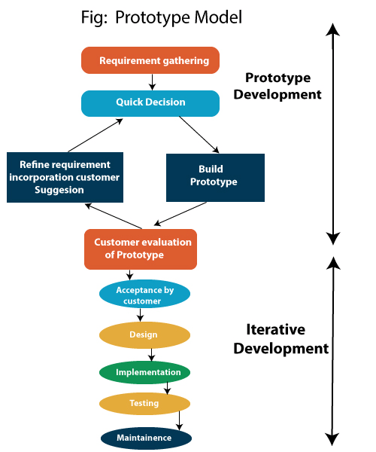
Software Development Process
Prototype Model

Slide 16

Software Development Process
Spiral Model
Determine Objectives
Identify & Resolve Risks
Prototype 1
Prototype 2
Prototype 3
Customer Evaluation
Develop next level of product

Slide 17
Software Development Process
Program vs. Software
Parameter | Program | Software product
Size | It is usually small in size. | It is large in size.
Developer | It has single developer. | Here, team of developers.
User | Author himself is sole user. | Large number of users.
Interface | It lacks proper user interface. | Here, well designed interface.
Documentation | It lacks proper documentation. | Here, well documented and user manual prepared.
Functionality | It provides limited functionality and less features. | It provides more functionality.
Development | No need of systematic, organized and planned development. | Require proper systematic, organized and planned development.

Slide 18
Software Development Process
End
Of
Chapter

